Slide 1
Alberta Home Care Policy Revision 2023
Marie Caluttung, BScN RN, Home Care Nurse Advisor
Pam Tailfeathers Buffalo, BN MSc RN, Special Projects
July 6, 2023
Notes:
Welcome all HCNs to our presentation today – Alberta Home Care Policy Revision 2023

Slide 2
Land Acknowledgment
I acknowledge that what we call Alberta is the traditional and ancestral territory, and home to the peoples of Treaty 6, 7 and 8.
First Nations, Métis and Inuit have lived here and cared for these lands for generations.
I am grateful for the traditional Knowledge Keepers and Elders who are still with us today and those who have gone before us. May we work in partnership to serve present and future generations.

Slide 3
In this presentation…
Background and Acknowledgements of the Revised Policies
Validation Process
Definition of Policies
The Value of Policies
Policy Template
Added Policies
Policy 2.5.18. Delegation to an Unregulated Care Provider
Policy 8.21 Palliative Care
Policy 7.21 Employee Mental Health
Case management and the LPN scope of practice
Where to find the new Policy Manual

Slide 4
Background
These 2023 policies have been adapted from the 2002 Alberta FNIHCC Program Policies Manual, revised by the HCCPNWG and those who attended the HCN 2022 conference
Notes:
The Regional Home Care Program and the Home and Community Care Nurses Working Group (HCCNWG) will adapt any further revisions to the policies for distribution to the First Nation communities.

Slide 5
Acknowledgements
Home and Community Care Program Nurses Working Group (HCCPNWG)
Treaty 6:
Marina Sangrey, LPN – Saddle Lake Health Services
Susan McGillis, RN BN – Enoch Health Servvices
Treaty 7:
Lani Blackwater, RN BN – Piikani Health Services
Cheryl Sorenson, RN – Siksika Health Services
Treaty 8:
Holly M. Best, RN BN – Kee Tas Kee Now Tribal Council
Shelly Gladue, RN BScN – Bigstone Health Commission
Notes:
The purpose of this group is to advise and consult with the Regional HCCP team and with home care staff in the communities to work toward coordinated implementation the FNHCCP.
The group membership comprised of 2 nurses from each treaty area and 2 members of the Regional Home Care team. The group was formed in 2013 and last met in 2017.

Slide 6
Acknowledgements
ISC Alberta Regional Home care Team
Lorene Weigelt, Pam Tailfeathers Buffalo and Marie Caluttung
Kee Tas Kee Now (KTC) Tribal Council

Slide 7
HCCP Validation Process
Revision and editing of the Policy Manual (2002) by the HCCPNWG.
Fall 2022 the SE FNIM Program attended the Alberta FNIHCC nursing education conferences (Edmonton & Calgary) each with 100+ participants, most of whom were HCC nurses and coordinators. Feedback was provided by the participants on the Table of Contents and additional policies were suggested and added as identified.
3. Regional Home and Community Care team reviewed and proofread the draft product.
4. Distribution to the communities of Alberta Region
Notes:
Alberta Regional Home and Community Care identified the need to provide communities with an updated concise resource, recognizing the changing needs of the clients and staff and reflecting current nursing practice and issues.
Regional Home and Community Care revised and edited the 2002 Policy version to provide clarity and up-to-date information and address any errors or omissions.
The process used was as follows: See Slide

Slide 8
Defining Policies
Policies provide guidance, standardization, and consistency in practice and reduce risks for clients and staff.
Should coincide with provincial governing bodies and always within the scope of practice of the staff member.
Best understood as a set of overarching principles and goals on how care is delivered and accessed.
.
Notes:
Note for Users; Please note that the 2023 Policies has been developed to reflect best practices and information at the time of writing. Therefore, it is the responsibility of those users of this manual to ensure they keep current on new policies for future needs. Home Care programs that are transferred to the Band have the choice to adapt, adopt or create their own policies based on their individual community needs.
I would like to reinforce that services provided to clients must be covered under a policy and coincide with the provider’s scope of practice.

Slide 9
The Value of Policies
For Individuals and Families
Policies are designed to promote client rights, client satisfaction, fairness, quality of care appropriate training and work satisfaction.
For Communities
Polices encourage ongoing program evaluation, quality improvement, cost-effectiveness, and client satisfaction.

Slide 10
The Value of Policies
For Community Leadership
Have responsibility of receiving, understanding & approving policies
Provide support for accreditation
For Program Staff
Policies provide clear direction & enable staff
to conduct their activities with confidence & efficiency.
Notes:
Program management has the responsibility of updating or implementing the approved policies and always ensuring adherence.
Program management is also responsible for monitoring, reviewing, and updating policies on a regular basis. Program staff are responsible for knowing the policies and adhering to them in their daily activities. Both Program management and staff participate in the review and revision of policies.

Slide 11
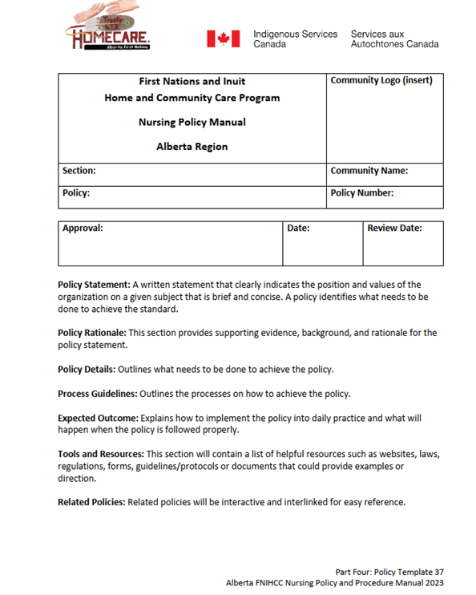
Policy Template
Page 37 in the Policy Manual
Notes:
Programs may use this if they want to create their own policy, Ex. IV Therapy in community

Slide 12
Policy Template
Policy Statement: A written statement that clearly indicates the position and values of the organization on a given subject that is brief and concise. A policy identifies what needs to be done to achieve the standard.
Policy Rationale: This section provides supporting evidence, background, and rationale for the policy statement.
Policy Details: Outlines what needs to be done to achieve the policy.
Process Guidelines: Outlines the processes on how to achieve the policy.
Expected Outcome: Explains how to implement the policy into daily practice and what will happen when the policy is followed properly.
Tools and Resources: This section will contain a list of helpful resources such as websites, laws, regulations, forms, guidelines/protocols or documents that could provide examples or direction. Related Policies: Related policies will be interactive and interlinked for easy reference

Slide 13
New HCCP Policies
40 Policies added by HCCPNWG & SE
9 more added by participants at HCN conference in Fall 2022
49 New Policies added overall
All other HCCP policies were revised to reflect current practice, resources and tools available

Slide 14
New HCCP Policies
2.1.6: Services: Transportation of Client in Staff Vehicles
2.5.14 Access to Services: Jordan’s Principle
2.5.15 Access to Services: Translator/Interpreter
2.5.16 Access to Services: Person and Family Centered Care
2.5.17 Access to Services: Therapeutic Relationships
2.5.18 Access to Services: Delegation to Unregulated Care Providers
3.3.1 Personal Health Information: Transmission: (Fax, Email)
3.3.2 Privacy and Mobile Technology: Telehealth
3.3.3 Social Media
4.3 Cultural Safety
4.6 Violence in the Workplace
4.7 Code of Conduct
4.8 Dress Code
4.20.3 Flu shot Certification
5.2.4 Feedback/Compliments/ Complaints
7.10 Infestations (Bed Bugs/Scabies/Lice)
7.16.1 Smoke Free Environment
7.16.2 Work Refuse and Withdrawal of Services
7.16.3 Animals/Pets in the Environment/Home
8.13.1. Medication Reconciliation
8.6 Harm Reduction
8.7 Point of Care Risk Assessment
8.8.1 Abuse: Adult
8.8.2 Abuse: Child
8.8.4 Abuse: Elder
8.14 Medication Administration
8.14.1 Narcotics/ Controlled Substances
8.14.2 Pre-pouring Medications and Oral Medication Setups
8.14.3 Injectable Medications (IM/SC
8.14.5 Inhalation Therapy
8.15 Sharps Management
8.16.1 Oxygen Safety in the Home
8.18 Wound Care
8.21 Palliative Care (supportive service)
8.21.1 Early Identification
8.21.3 Palliative Assessment Tools
8.21.4 Managing Symptoms
8.21.6 Preparing for End of Life
8.23 Pronouncement
8.25 Medical Assistance in Dying
Added based on feedback at Fall Nurses gathering 2022
4.10.8 Contracted services
4.20.22 Advanced Practice Nursing
7.20 Debriefing after Trauma
7.21 Employee Mental Health
8.13.11 Medication Assistance- Delegation to HCA
8.29 Caregiver Burnout
8.30 Respite
8.31 Caregiver Grief
8.32 Safe Bathing
Notes:
Policy – Social Media
Encourage the participant to review and familiarize
48 New Policies and highlight a few that are most relevant to the present time

Slide 15
Policy 2.5.18. Delegation to an Unregulated Care Provider
This policy outlines:
the professional responsibilities and accountabilities of Registered Nurses (RNs) and Licensed Practical Nurses (LPNs)
the responsibility and accountability of the nurse (RN, LPN) when assigning or delegating tasks to unregulated care providers (i.e., HCAs)
Notes:
Policy Rationale:
To ensure the delegation of nursing tasks to unregulated care providers is performed in a
manner that protects the client, the nurse and the unregulated care provider.

Slide 16
Policy 2.5.18 Delegation to an Unregulated Care Provider
Notes:
Policy Details: “In the present health care environment collaboration of the members of the health care team is
valued and encouraged. Well-functioning teams have shown great promise in delivering quality
care and contributing to patient safety.” (Pan-Canadian Planning Committee on Unregulated
Health Workers, 2008)

Slide 17
Policy 2.5.18 Delegation to an Unregulated Care Provider
Delegation is a three-part process:
1. Assessment of the client and their situation, as well as of the competence of the care
provider.
2. Delegation of the task
3. Supervision
Notes:
“Increasingly, health care aides are part of the staff mix. Clear job descriptions and educational programs to ensure the attainment of necessary competencies will increase trust in and respect for the health care aide. This will contribute to the integration of the health care aide as a valued member of the health care team. Effective communication is critical to ensure the sharing of necessary information between the health care aide and the nurse and to integrate the care activities.” Decision-Making Standards for Nurses in the Supervision of Health Care Aides”. (College of Licensed Practical Nurses of Alberta and the College of Registered Nurses of Alberta, 2010, current as of 2023)

Slide 18
Policy 2.5.18 Delegation to an Unregulated Care Provider
Delegation can be very complicated. It is recommended that nurses review:
Decision-Making Standards for Nurses in the Supervision of Health Care Aides. (College of Licensed Practical Nurses of Alberta and the College of Registered Nurses of Alberta). (2010)
Notes:
This document defines:
Assigning Care to the HCA - Decision Tree Restricted Activity or Activity of Daily Living algorithm.
Supervision of the HCA – Nursing Assessment/Nursing Care Planning/Nursing Plan Implementation/Evaluation of Nursing Care
Guidance for other Care commonly provided by HCAs – assistance with Medication/Vital Signs/Feeding/documentation by HCAs

Slide 19
Policy 2.5.18 Delegation to an Unregulated Care Provider
Expected Outcome:
Nurses practice to their full scope, utilizing unregulated care provider resources wisely and appropriately, with the goal of ensuring that clients receive the best care from the appropriate staff member.

Slide 20
Policy 8.21 Palliative Care
The palliative care approach is appropriate for any individual and/or family living with a life limiting illness due to any diagnosis, with any prognosis, regardless of age.
The palliative approach to care may coexist with and enhance existing disease treatments, or it may be the total focus of care.
Notes:
Indigenous people experience higher rates of chronic and
communicable diseases at much younger ages. The importance of early identification of
those who would benefit from a palliative approach to care is essential to ensure
optimal outcomes. Examples: Diabetes, COPD, Stroke , Hepatitis C, Arthritis, Dementia and Cancer

Slide 21
Policy 8.21 Palliative Care
Expected Outcomes:
The client and family have an increased understanding of the illness and can identify their values and goals.
Clients will have a complete and documented advance care plan
Clients have less anxiety as a result of the autonomy in care needs.
Clients have a better quality of life and end of life.

Slide 22
Policy 8.21 Palliative Care
8.20.1. Early Identification
8.20.2. Advance Care Planning
8.20.3. Palliative Assessment
8.20.4. Managing Symptoms
8.20.5. Preparing for End-of-Life
Notes:
8.20.1:Creates opportunities for the nurse to engage in conversations with the
client and family. Conversations can be more meaningful, thoughtful and impactful, as they are pre-planned.
8.20.2. Advance care planning is a process that supports clients at any age or
stage of health in understanding and sharing their personal values, life goals and preferences
regarding future medical care. The goal is to help ensure that the
client receives the medical care that they wish to have.
8.20.3. Initial and ongoing assessments guided by evidence-based tools
provide a baseline and ensure the early detection of symptoms. This allows for high-quality and
timely symptom management and facilitates timely access to higher levels of care and
prevention activities.
8.20.4. Managing Symptoms: Palliative symptom management approaches disease and EOL in a wholistic manner, addressing
not only the physical aspect of symptoms but also the mental, emotional and spiritual
dimensions of suffering, for total symptom relief.
8.20.5. Preparing for End-of-Life :
The goal of EOL care is to honour and respect the client’s choices, wishes and goals of care. The dying
process is unique to the individual. The home care staff will provide
meaningful connections and ease the transition from life to death for the client and their
families.

Slide 23
Policy 7.21 Employee Mental Health
The Alberta First Nations Home and Community Care Program (AFNHCCP)/Community is committed to:
promoting and restoring the mental and physical well-being of all employees
will identify possible workplace stressors through risk assessments to eliminate or reduce them where possible.
Notes:
This policy was identified by the Nurses at the 2022 Fall conference, recognizing that mental health has become an issue for Home Care staff and their families.
Many factors have contributed to the increase in mental health issues most recently: Covid related outcomes such as isolation of family and community; the discovery of unmarked graves at many Residential schools opening old wounds; intergenerational trauma; increase of alcohol and drugs use to cope; increasing demands of the job; and shortage of staff in communities to name a few.

Slide 24
Policy 7.21 Employee Mental Health
Notes:
Effects of Mental health in the Workplace: Mental health concerns can prevent employees from being fully focused and doing
their best work. An imbalance in employees’ well-being can lead to burnout, disengagement,
increased sick days and strained relationships in the workplace.
Signs and symptoms of an employee’s declining mental health: • Changes in an employee’s work attitude, work habits or performance • Physical changes (fatigue, low activity, sleep difficulties) • Changes in personality or behaviour (lack of interest, listlessness, anger) • Changes in substance use (alcohol, nicotine)

Slide 25
Policy 7.21 Employee Mental Health
Supports and Tools: Occupational & Critical Incident Stress Management (OCISM) services are provided by (First Nations Inuit Health Branch) FNIHB to all nurses serving First Nations communities.
The OCISM program was developed and implemented to assist nurses who are struggling with mental health concerns.
The goal of OCISM services is to safeguard the well-being of nurses.
Notes:
Similar programs and studies show that providing prompt OCISM support to those involved in critical incidents results in enhanced recovery and faster recovery times.

Slide 26
Policy 7.21 Employee Mental Health
Supports and Tools
Hope for Wellness:
Available to all Indigenous people across Canada. Experienced and culturally competent counsellors are available by telephone and online chat 24/7
Notes:
They provide help with experiences, challenges and issues big or small, when feeling distressed,
or to help to find other wellness supports available in the area.
Both telephone (1-855-242-3310) and online chat services are available in English and French.
Telephone support is also available upon request in:
• Cree
• Ojibway (Anishinaabemowin)Policy 7.21. Employee Mental Health 563
Alberta FNIHCC Nursing Policy and Procedure Manual 2023
• Inuktitut
(Note: Supports in Cree, Ojibway and Inuktitut are not available 24/7, so you may need to call in
to find out the next time that a language speaker will be available.)

Slide 27
Policy 7.21 Employee Mental Health
Supports and Tools
Traditional healing practices to include;
Sweatlodge, Sundance, Tea dances, dancing & singing
Elder-in-Residence Program
Employee Assistance Program (EAP) for Federal Employees

Slide 28
Policy 7.21 Employee Mental Health
Expected Outcomes
The AFNHCCP/Community
promotes the mental and physical well-being of all employees
will identify possible workplace stressors through risk assessments to eliminate or reduce them where possible.
All AFNHCCP/Community employees who are experiencing mental health concerns feel they are supported by all home care management and staff.
Notes:
Process Guidelines:
The AFNHCCP/Community program will: • Promote the mental well-being of all employees through: o Providing information and raising awareness about mental well-being. o Providing opportunities for employees to look after their mental well-being. o Promoting policies and practices that promote well-being. • Develop skills for managers and supervisors to: o Promote the mental well-being of employees. o Deal with issues around mental health and stress effectively.
The AFNHCCP/Community managers will: • Ensure good communication, especially in times of change. • Ensure employees are fully trained to do their jobs and are provided professional development opportunities as needed and available. • Monitor workloads, overtime requirements and vacation allotments. • Attend training to recognize and deal with harassment and bullying. • Support employees experiencing stress in their personal lives (e.g., bereavement, divorce, illness, etc.). • Provide flexible work schedules where possible. • Support employees who have been on sick leave and help to facilitate their return to work. • Monitor and review the effectiveness of measures to relieve stress. The AFNHCCP/Community employees will: • Bring issues of concern to health and safety representatives, occupational health representatives and/or managers as soon as they are recognized. • Access the OCISM program/Hope for Wellness as needed. • Be aware of and follow all workplace policies around bullying and harassment. • Promote their mental well-being (e.g., diet, exercise, meditation).

Slide 29
Updates Policy: Case Management and the LPN
Case Management
CLPNA have expanded the LPN role case manager and be able to complete an initial assessment
Date of presentation August 30, 2023 on TSAG Telehealth
CLPNA representative will attend as special guest
Notes:
Nurse authorizer, Case management and initial assessment

Slide 30
Don’t forget…
Lippincott Procedure Manual on Onehealth.ca in Home Care Resources:
Access procedures through Alberta Health Services (AHS) website ‘Continuing Care Connection’ (CCC) website to support your practice.
Lippincott is evidence-based reference, providing access to step-by-step guides for procedures and skills.
This resource should be used in consideration of your clinical experience, context-specific information, client need, organizational policies, and the practice environment.
Notes:
Visit Sign In (albertahealthservices.ca)
Click on ‘register’
Fill out registration fields to the best of your ability
Under ‘classification’
Choose most appropriate AHS zone for your home care office
Scroll through organization and select ‘First Nations Home Care Offices’
Select ‘Home Living’ care stream
Choose most appropriate occupation for your position
Once Signed-in, to access Lippincott Procedures:
Click on Learning drop down menu
Select Education
Lippincott Procedures is listed under Additional Resources

Slide 31
Next Steps
Review policies
Adopt, Adapt or revise them to your community needs
or submit Feedback Form to the Regional Office to suggest a change to the policy
Have your Health Director/Board of Directors/Chief and Council formally adopt
Add community logo
Sign off you have read them

Slide 32
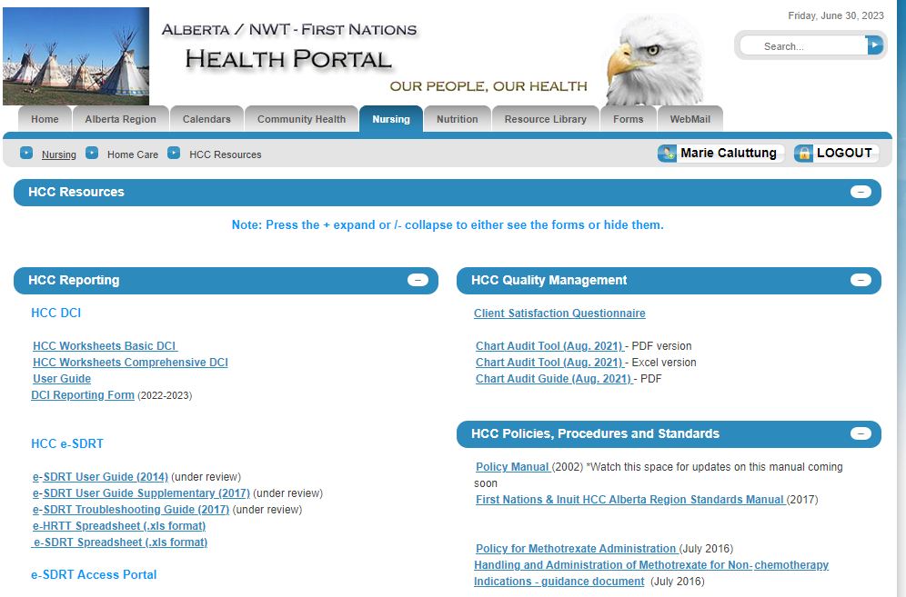
Where you will find the Home Care Policy Manual
Onehealth.ca under Nursing/Homecare/Resources

Slide 33
Questions
Photo credit: Magda Ehlers

