Slide 1
COVID-19 MOH Update
Current Topic, Scenarios and a community profile
April 23, 2020

Slide 2
Outline
1. MOH Update
2. Mass Gatherings
3. Scenarios
4. Community Profile – Saddle Lake
5. Questions

Slide 3
MOH Update
Dr. Wadieh Yacoub, Senior Medical officer of health
Dr. Chris Sarin, Medical officer of health

Slide 4
Current Situation
The global numbers as of April 22, 2020 (WHO Situation Report – 93)
2 471 136 confirmed cases
169 006 deaths
The United States is reporting the highest number of cases, followed by Spain, Italy, Germany, the United Kingdom, and France.
Source: World Health Organization https://www.who.int/emergencies/diseases/novel-coronavirus-2019/situation-reports/ and Public Health Agency of Canada https://www.canada.ca/en/public-health/services/diseases/2019-novel-coronavirus-infection.html

Slide 5
Current Situation
The numbers in Canada as of April 22, 2020:
40,179 confirmed cases
1,974 deaths
Source: PHAC https://www.canada.ca/en/public-health/services/diseases/2019-novel-coronavirus-infection.html

Slide 6
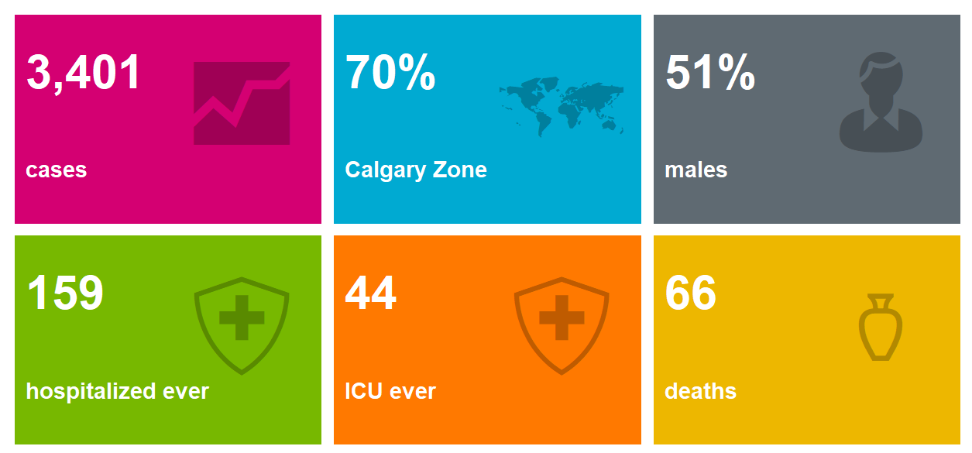
Current Situation
Overview of COVID-19 in Alberta (as of April 22, 2020):
Interactive Alberta data can be found at: https://covid19stats.alberta.ca/

Slide 7
Current Situation
The numbers across Alberta as of April 22, 2020:
Location | Total Confirmed Cases | Deaths
Calgary Zone | 2 396 | 42
Edmonton Zone | 451 | 9
South Zone | 303 | 0
North Zone | 150 | 14
Central Zone | 79 | 1
First Nation Communities | 1 | 0
Unknown | 20 | 0
TOTAL | 3 401 (1 310 Recovered) | 66

Slide 8
COVID-19 Testing
Alberta has expanded access to laboratory tests to better trace the spread of COVID-19.
Testing is to any person exhibiting symptoms of COVID-19 including cough, fever, shortness of breath, runny nose or sore throat.
To determine if you need to be tested and next steps, complete the:
AHS Online COVID-19 Assessment, or
https://myhealth.alberta.ca/Journey/COVID-19/Pages/COVID-Self-Assessment.aspx
AHS Online Assessment for Healthcare and Shelter Workers, Enforcement Personnel and First Responders.
https://myhealth.alberta.ca/Journey/COVID-19/Pages/HWAssessLanding.aspx
Notes:
Asymptomatic testing

Slide 9
COVID-19 Testing
As of April 22, 108 521 people have been tested in Alberta.
Calgary Zone has completed 44% of the tests.
Trend has been increasing for the percentage of positive tests.
Increased testing due to a number of outbreaks, including reported outbreaks in health facilities, as well as outbreaks associated with gatherings.
Notes:
Calgary Zone 47,504 (44%)
Edmonton Zone – 34,629 (32%)
Central Zone – 9.961 (9%)
North Zone – 8,779 (8%)
South Zone – 5,837 (5%)
Unknown – 1,811 (2%)

Slide 10
COVID-19 Testing Data: First Nations Communities in Alberta (as of April 21)

Slide 11
Mass Gatherings
Dr. Wadieh Yacoub, Senior medical officer of health

Slide 12
Public Health Order - Gatherings
Restrictions and prohibitions on gatherings were put into effect to protect Albertans and prevent the spread of COVID-19. Gatherings of more than 15 people are prohibited as per CMOH Order 07-2020:
Gatherings in outdoor public spaces are limited to groups of 15 people in one location and all persons must observe 2 metre distancing requirements
Gatherings in an indoor location must also be limited to 15 people and all persons must observe 2 meter distancing requirements
This applies to any private or public gathering including, but not limited to, weddings, funerals, religious services and informal events etc.
Further information can be found at: https://open.alberta.ca/publications/cmoh-order-07-2020-2020-covid-19-response

Slide 13
COVID-19 Public Health Orders
COVID-19 public health orders under the Alberta Public Health Act are enforceable by law:
Violators may be subject to tickets of $1,000 per occurrence. Courts could administer fines of up to $100,000 for a first offence and up to $500,000 for a subsequent offence for more serious violations.
Complaints can be submitted:
Online through Alberta Health Services - https://ephisahs.albertahealthservices.ca/create-case/
Call Alberta Health Services at 310-4455 to submit a complaint by leaving a message when prompted.

Slide 14
Funerals, Wakes and Memorials
It is difficult to lose a loved one under normal circumstances, and is more difficult given the current COVID-19 pandemic situation. We understand that the need to gather, to recognize, to mourn, to support each other, is human. Not being able to have a funeral, memorial or other traditional/cultural ceremony following the death of a loved one, can be heartbreaking.
Funerals, however, like all other public gatherings, are very risky at this time. Even small gatherings can increase the possibility of spreading the COVID-19 virus. It can be particularly dangerous for Elders and people with pre-existing medical conditions to attend events such as funerals.
It is essential that public health directives regarding public gatherings and physical distancing continue to be followed under all circumstances.

Slide 15
Practical Guidance for Funerals, Wakes and Memorials
The following guidance outlines how to ensure COVID-19 is not transmitted during this time. This guidance should be followed regardless of the cause of death.
Funeral services not involving burial should be postponed as much as possible
The dignity of the deceased, their cultural and spiritual traditions and their families should be respected and protected throughout
People who have died from COVID-19 can be buried or cremated
Notes:
Whenever possible, postpone any physical gatherings
Consider excluding children, elderly, immunocompromised and other vulnerable individuals from the gathering.
Anyone experiencing symptoms of COVID-19 must not attend

Slide 16
Practical Guidance for Funerals, Wakes and Memorials
Wakes and funerals are unique situations due to their emotional and spiritual components. If burial is being postponed, viewing of the deceased is still possible. Whether the viewing is in the home, or in a pre-determined facility, the following procedures are recommended:
Consider limiting the number of people involved in the ceremony to only members of the immediate family/same household.
Limit number of people to less than 15 (as per AB CMOH Order)
Ensure strict physical distancing can be achieved (includes outdoor gatherings)
Consider staggering arrival/departure times of attendees
Consider the use of virtual technologies (e.g. telephone, video conference, video recordings) in place of in-person services and gatherings. Posting these on social media, publically or privately will need to be in keeping with the family wishes.
Notes:
There should be no direct contact with the body.
There should be no direct contact between attendees and any sharing of objects should be avoided.
Preparing and providing food is discouraged.
If food is provided, it should be pre-packaged and follow general food safety precautions.

Slide 17
Practical Guidance for Funerals, Wakes and Memorials
Individuals who are ill, or have high-risk medical conditions must not attend. Friends, family and other visitors should not touch or kiss the body.
Wearing a homemade facial covering that covers your mouth and nose may be helpful in providing some protection for others around you, for a short period of time^{3.}
Ceremonial objects should not be shared amongst participants.
Should touching of the body or clothing occur, ensure that the individuals wash their hands thoroughly with soap and water or applies hand sanitizer (with alcohol content 60% or more).
Maintain a list of all participants, in the event that tracing needs to be done.
DO NOT permit self-serve buffets. If necessary, provide single-serve foods in individual containers, maintaining physical distancing of 2 metres or 6 feet.
Notes:
Hand sanitizer should be provided for family and attendees to use.
Attendees should be encouraged to thoroughly wash their hands following the event.
Make provisions for cleaning and sanitizing high touch surfaces during and after the event.

Slide 18
Resources
AB CMOH Order 07-2020: https://open.alberta.ca/dataset/c02f3b06-9c37-4845-98ee-d07d805fdce1/resource/32f3367d-9a15-4aef-af6e-4e960891c14e/download/health-cmoh-record-of-decision-cmoh-07-2020.pdf
Practical Guidance for Funerals, Wakes and Memorials During the Current COVID-19 Pandemic Situation
Dr. Tom Wong Chief Medical Officer of Public Health - http://www.onehealth.ca/ab/ABCovid- 19
Alberta Health COVID -19 Orders and Legislation https://www.alberta.ca/covid-19-orders-and-legislation.aspx
Alberta Health Services COVID -19 Public Health Order Violations https://ephisahs.microsoftcrmportals.com/create-case/

Slide 19
Scenarios
CDC Team - Christina smith, Andrea Warman, brent whittal

Slide 20
Scenario
A client comes in requesting a test for COVID-19.
He does not have any COVID-19 symptoms and does not meet the exposure criteria.
The nurse tells the individual he does not need to be tested.
He states he is going to the health director and community leadership to have them make the nurse do the test.
The nurse receives a phone call to say “Test the individual or you will be fired”.
Should the nurse do the test?

Slide 21
This is a very difficult situation:
The nurse doesn’t want to damage the nurse- patient relationship
The nurse’s job is potentially in jeopardy
If the nurse does the test, it would be outside of the scope of when she is able to test
The nurse wonders, “Would an extra test sent to the lab make such a big difference?”

Slide 22
Discussion
The nurse has assessed the client correctly and he does not meet the testing criteria outlined in the FNIHB MOH directive.
The nurse is not covered by the FNIHB MOH to test anyone outside of the testing criteria.

Slide 23
Discussion (con’t)
The nurse could:
Consult with a local physician or NP who could order a test if they feel it is required
Call a member of the CDC Team to review the situation
Call the MOH on call (780-218-9929) to review the situation

Slide 24
Support for Nurses
FNIHB MOH and CDC Team
Able meet with the individual or community by phone to review the guidelines for testing
Registered bodies for nurses
College of Registered Nurses of Alberta (CARNA)
College of Licensed Practical Nurses of Alberta
Employee Assistance Programs
Occupational & Critical Incident Stress Management (OCISM) for nurses (FNIHB and Nation employed) 1-800-268-7708

Slide 25
Scenario
I have collected a swab for COVID-19.
How do I fill out the lab requisition?

Slide 26
Lab Requisition
There are several types of lab reports used around the province.
Each of them are slightly different

Slide 27
Lab Requisition
There is some key information that is required on the lab requisition:
Patient information
Provider/Requestor information
Specimen/Collection information

Slide 28
Lab Requisition
Patient Information Section
Information required:
PHN (health care number)
Date of Birth
Legal Last Name, Legal First Name
As it shows on their health care card
Address

Slide 29
Lab Requisition
If you are ordering under FNIHB’s MOH the following information is required in the Provider or Requestor section:
Name: Yacoub, Wadieh
Address: Canada Place, Edmonton, AB
Phone: 780-495-3391
Provider ID: 004699A

Slide 30
Lab Requisition
Copy To portion in the Provider or Requestor section:
If you are ordering under your local physician or nurse practitioner, enter his/her information in the Provider or Requestor section and enter Dr. Yacoub’s information in the Copy To section.
If you are ordering under Dr. Yacoub and the client has a regular physician, his/her information can be entered in the Copy To section.

Slide 31
Lab Requisition
Specimen or Collection Section
Routine collection (not usually Stat)
Date of collection (use the format identified on the form)
Time of collection (using the 24 hour format)
Location: the name of your health centre
Outbreak EI: only filled in if applicable. The CDC team would most likely relay this information to you if it is required. (con’t)

Slide 32
Lab Requisition
Specimen or Collection Section (con’t)
Swab:
Nasopharyngeal
Throat
Nasal
Reason for Testing/Clinical Information:
COVID 19 symptoms (some may have check boxes for symptoms)
Onset of symptom date
Travel out of country history if applicable (in last 14 days) (con’t)

Slide 33
Lab Requisition
Specimen or Collection Section (con’t)
COVID-19 does not usually appear on the lab requisition as one of the tests available.
Write “COVID-19” in the “other” or “additional” test section that is usually found at the bottom of the lab requisition.

Slide 34
Lab Requisition
Your local laboratory is a great source of information if you have questions
If lab requisitions are not completed in full, the lab specimen may not be tested
The information on the lab requisition MUST match the information on the specimen that was collected.

Slide 35
Scenario
I have tested a client for COVID-19.
How does the client get the lab results?

Slide 36
Lab Results
A FNIHB MOH will be notified by phone of all positive lab results.
The ordering physician, FNIHB MOH or CDC Team will usually be the ones to notify the client of the results.
The CDC Team will reach out to the community health nurse as soon as possible to start case management and contact tracing.

Slide 37
Lab Results
There are a few ways for the client to get their negative lab results:
From the ordering physician/NP or nurse
Nurses ordering testing under Dr. Yacoub are responsible for checking NetCare for lab results and relaying negative results to the client.
Note: if the nurse does not have NetCare access, the CDC Team can watch for lab results until NetCare access is obtained. Client information must be relayed to the CDC Team. (Con’t)

Slide 38
Lab Results
Clients will receive a phone call from Health Link (811) to inform them of a negative test result.
Clients may view their health information on line if they have registered in the MyHealth Records program. (myhealth.alberta.ca)
If consent was obtained at the time of specimen collection, clients can receive negative results via an automated message sent by the COVID-19 Auto-dialer program.

Slide 39
What is the COVID-19 Auto-Dialer?

Slide 40
What is COVID-19 Auto-Dialer?
An automated phone call from Albert Health Services reporting NEGATIVE COVID-19 results to people who consent at the time of testing.

Slide 41
How the COVID-19 Auto-Dialer Works
A person getting tested for COVID-19 consents to this reporting option at the time of swabbing
Consent and phone number is documented on lab requisition and goes with the specimen to the laboratory
A NEGATIVE test result is entered into auto-dialer system
A call to the client is made the next morning

Slide 42
How COVID-19 Auto-Dialer Works
The client answers the call, responds to prompts, listens to the message, and acknowledges receipt of the information by pressing a key. Process ends.
If no one answers, a clear message is left to expect a repeat call.
Two more such calls are made, the last one is at 4:00 p.m.
The following day Health Link staff will attempt to manually call the person.

Slide 43
COVID-19 Auto-Dialer
Over the last week, the FNIHB CDC Team has been meeting with Precision Labs and the AHS COVID-19 Surveillance Team.
A custom lab report must be used in order to participate in the Auto-Dialer process
A lab requisition with Dr. Yacoub’s information is being created
Note: the custom lab report can also be used for clients that do not want to participate in the auto-dialer process.

Slide 44
COVID-19 Auto-Dialer
Informed consent must be obtained from the client if the auto-dialer process is going to be used.
This is important because medical information is being relayed and it may not be the client who picks up the auto-dialer phone call.
On the lab requisition, there is a consent box that must be checked off.
Even if the client has consented to the auto-dialer process, nurses who collect COVID-19 specimens need to monitor NetCare for results.

Slide 45
COIVD-19 Auto-Dialer
Next Steps:
FNIHB CDC Team will receive the custom lab report required for the auto-dialer process.
The custom lab requisition and information on the auto-dialer process will be sent out by email to all community health nurses.

Slide 46
Thank you for all the work that you are doing in the community.
The CDC Team

Slide 47
Community COVID-19 Response Profile – Saddle Lake Health Centre
Dr. Nicole cardinal
Troy tilley, NIC
tamara large, lpn

Slide 48
Saddle Lake – COVID-19 Response

Slide 49
Saddle Lake – COVID-19 Response

Slide 50
Saddle Lake – COVID-19 Response

Slide 51
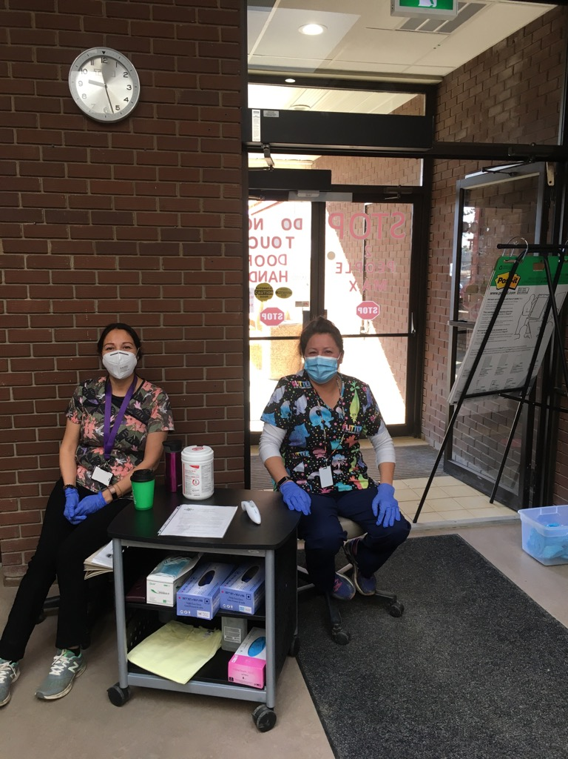
Saddle Lake – COVID-19 Response

Slide 52
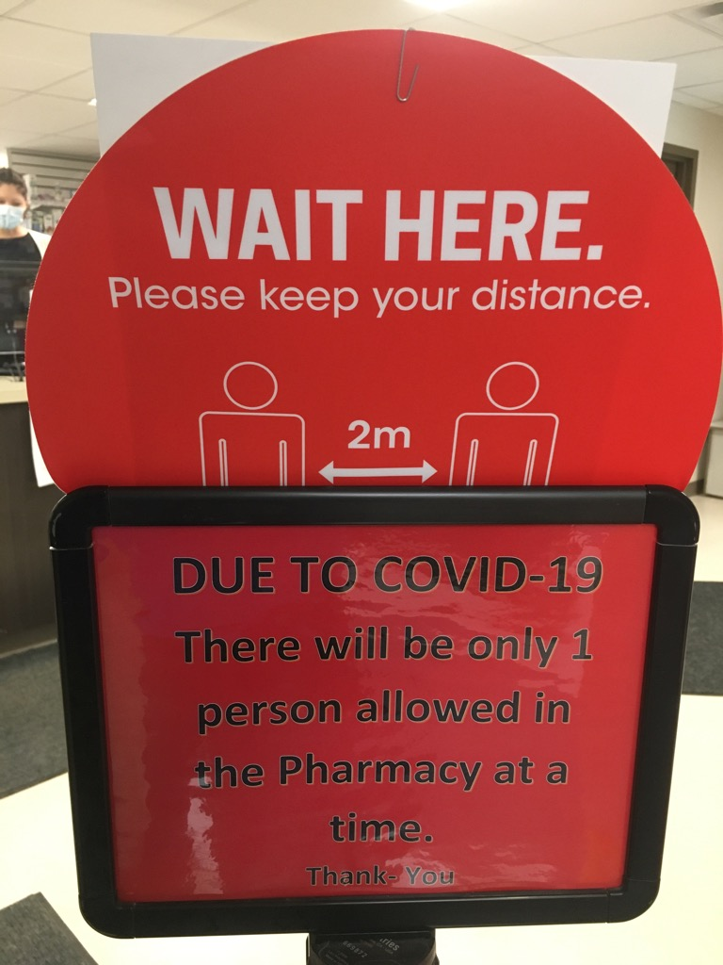
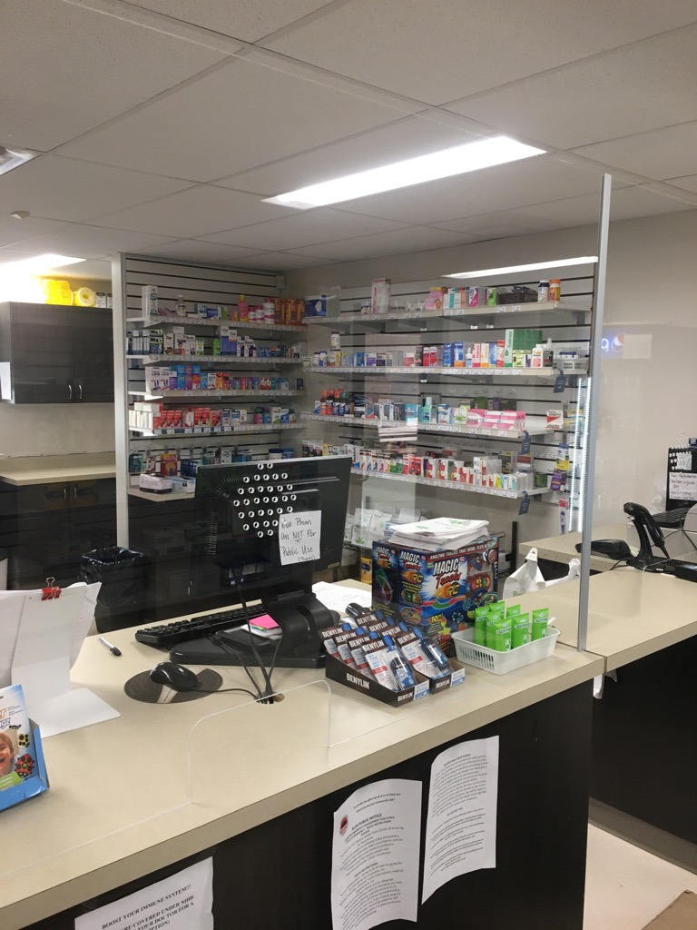
Saddle Lake – COVID-19 Response

Slide 53
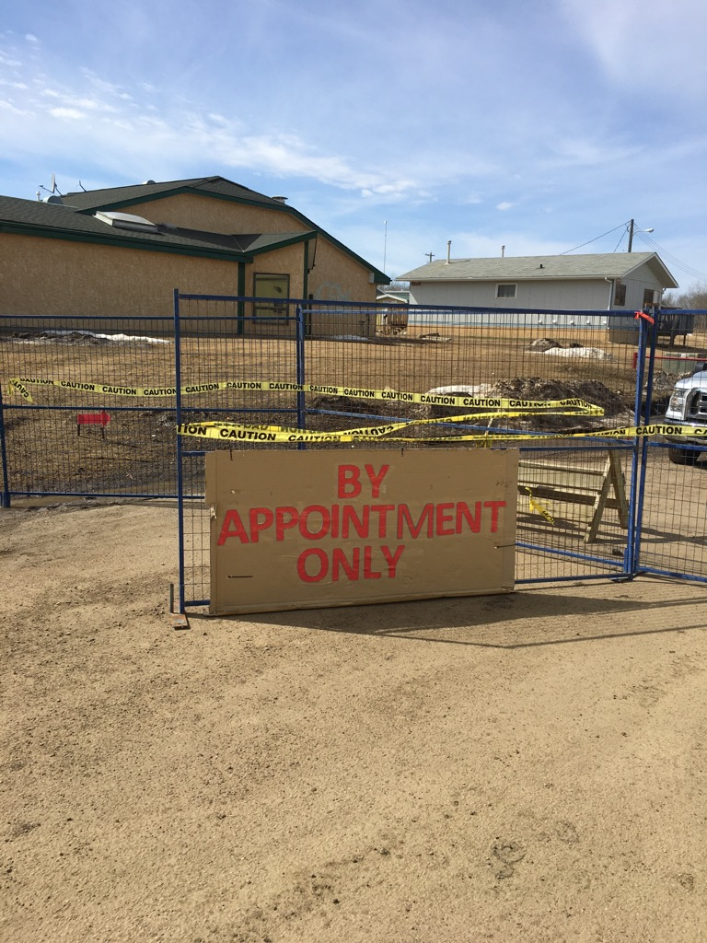
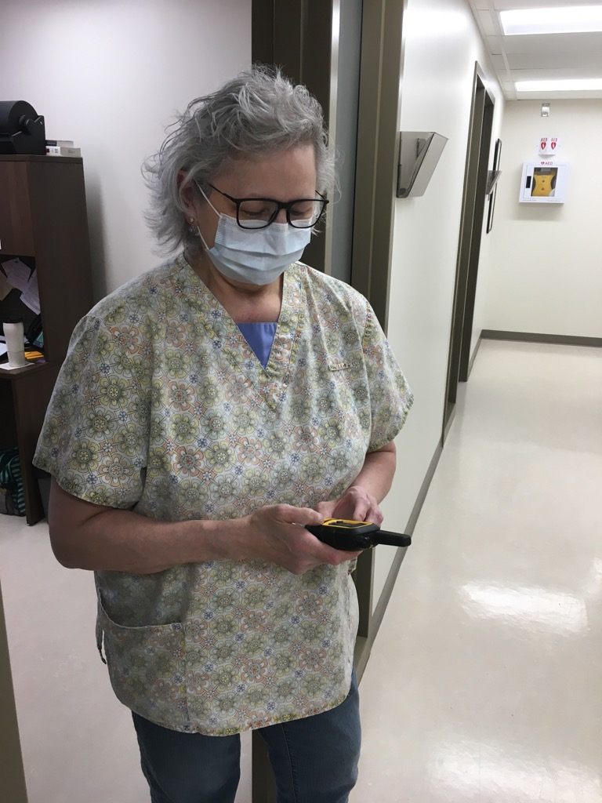
Saddle Lake - COVID-19 Testing Site

Slide 54
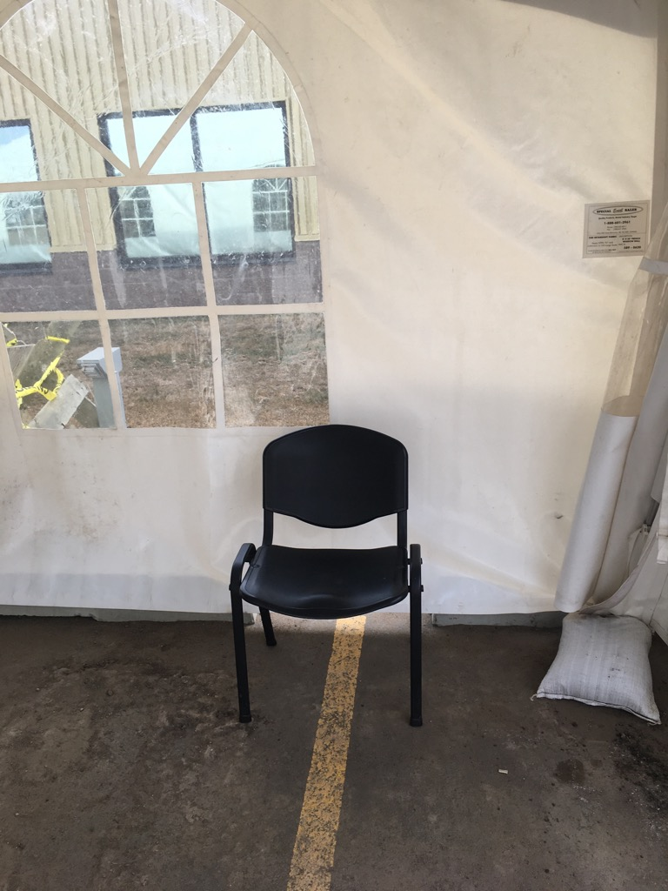
Saddle Lake - COVID-19 Testing Site

Slide 55
Saddle Lake - COVID-19 Testing Site

Slide 56
Saddle Lake - COVID-19 Testing Site

Slide 57
Saddle Lake - COVID-19 Testing Site

Slide 58
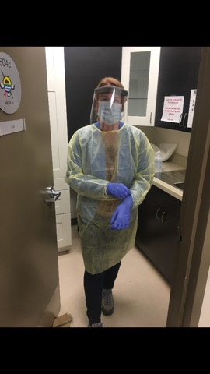
Saddle Lake - COVID-19 Testing Site

Slide 59
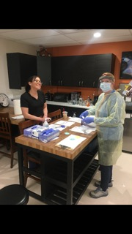
Saddle Lake - COVID-19 Testing Site

Slide 60
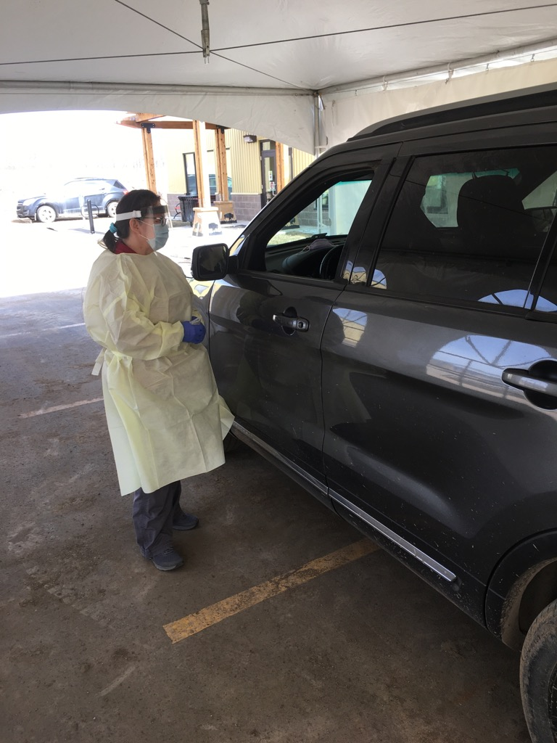
Saddle Lake - COVID-19 Testing Site

Slide 61
Saddle Lake - COVID-19 Testing Site

Slide 62
Saddle Lake - COVID-19 Testing Site

Slide 63
Saddle Lake – COVID-19 Response

Slide 64
Acknowledgments
Dr. Wadieh Yacoub, Senior Medical Officer of Health
Dr. Chris Sarin, Deputy Medical Officer of Health
Dr. Stephen Hodgins, School of Public Health University of Alberta
Christina Cardinal, CDC Nurse Manager
Andrea Warman, TB Program coordinator
Brent Whittal, CDC Nurse
Dr. Nicole Cardinal – Saddle Lake Health Centre
Troy Tilley, NIC – Saddle Lake Health Centre
Tamara Large, LPN – Saddle Lake Health Centre
TSAG Telehealth Team (Michelle Hoeber, Brooke Hames and team)

Slide 65
Questions?
VCHELP@FNTN.CA

