Slide 1
PREVENTION CONVERSATION
IT’S TIME TO TALK ABOUT ALCOHOL AND PREGNANCY
EDMONTON AND AREA FETAL ALCOHOL NETWORK

Slide 2
FASD
What does it stand for?
How does FASD happen?
How many Albertans have FASD?
How many babies a year are born with FASD in Alberta?
Can the father cause FASD?

Slide 3
A drink is a drink

Slide 4
MYTH OR FACT?
Alcohol causes more damage to the developing baby than heroin does?
Drinking alcohol is only harmful to the baby during the first trimester?
If a mother drinks a lot and has a normal, healthy baby then her second child will be ok if she continues to drink?
The effects that alcohol has on a newborn will gradually go away as the child gets older?
Women at the lowest income bracket are more at-risk to consume alcohol while pregnant?

Slide 5
COST OF FASD IN ALBERTA:
Total annual cost of FASD
Lifetime cost per case of FASD
Why do you think it is so expensive?

Slide 6
QUICK STATS
83% of individuals with an FASD cannot live independently
93% of individuals with an FASD suffer from mental health problems
50% of males and 70% of females with an FASD have problems with alcohol and drug abuse
78% of individuals with an FASD have problems with employment
It is estimated that 50%-70% of our inmate population are individuals with FASD
At least 60% of individuals with FASD have problems with the law

Slide 7
Example of a Developmental Timeline for 18-year-old with an FASD

Slide 8
WORKING WITH SOMEONE WITH FASD
Keep it simple
Slow down, allow time to adjust to new activities/environments
Allow for a lot of breaks
Connect individual with a support person
Try different (ways), not harder
Communicate using concrete language and examples
Focus on strengths
Ask questions to check for understanding
Alter the environment
Be organized
Have consistent routines
Be with clear with expectations
Remember developmental age

Slide 9


THE PREVENTION CONVERSATION: A SHARED RESPONSIBILITY PROJECT

Slide 10
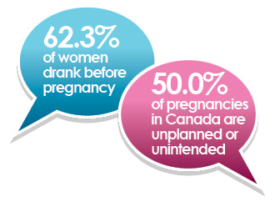
PREVENTION CONVERSATION
Translation: If you drink alcohol and are having sex, take a closer look at whether your birth control is doing what it’s supposed to. If you’re thinking about getting pregnant, it’s safest to stop drinking right now. If you drank before you knew you were pregnant, don’t panic – talk to your doctor to learn more.

Slide 11
BACKGROUND OF THE PROJECT
Based on the first and second levels of the Four-Part Model of Prevention (PHAC, 2008)
Focuses on engaging communities in conversations about drinking during pregnancy or drinking before a woman even knows they are pregnant
Supporting primary care providers to develop the necessary skills to engage in non-judgmental, empathetic conversations about alcohol use
Focus on community engagement as a means to train and support primary care providers in the use of the screening tolls and techniques to engage women in the ‘prevention conversation’

Slide 12
OBJECTIVES OF THE PROJECT
Increase the capacity of health and social services providers across the province to educate and support women and their partners using evidence-based practices to screen for alcohol use in pregnancy and intervene appropriately and effectively
Increase awareness among women of child-bearing age and their partners about the effects of drinking during pregnancy with a focus on early stage when pregnancy status may not be known
Increase knowledge of community resources available to women and their partners who may be concerned about alcohol consumption
Create community connections between health and social services and the FASD Service Networks to develop wrap around services

Slide 13
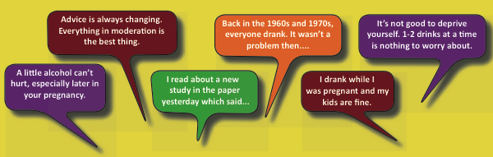
RISK AND EVIDENCE:
WHAT SHOULD WE BELIEVE?

Slide 14
MESSAGE #1
“ZERO FOR NINE”

Slide 15
MESSAGE #2
Drinking can be harmful at any point during pregnancy. The baby’s brain and nervous system develops throughout the entire pregnancy and may lead to a lifelong disability of FASD
  Why do some women drink alcohol while pregnant?

Slide 16
MESSAGE #3
Alcohol and pregnancy don’t mix. If you drink alcohol and are sexually active, make sure you use effective contraception.
  Change the message

Slide 17
MESSAGE #4
Some women need support, care, and treatment to help them to stop drinking during pregnancy
  What are some of the top barriers that pregnant women who are using alcohol face when trying to seek help and support?

Slide 18
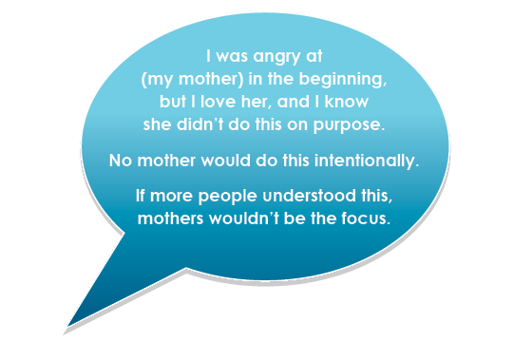
IS THERE SOMEONE TO BLAME?

Slide 19
MESSAGE #5
Friends, partners, and family members can support a pregnant woman by asking how they can help her to make healthy choices and healthy babies
  What are some ways that friends, partners, family, workers, etc. can support a women to have an alcohol free pregnancy?

Slide 20
Prevention Efforts Must…
Move the focus from a woman’s alcohol use to understanding the related health and social problems that contribute to FASD.

Slide 21
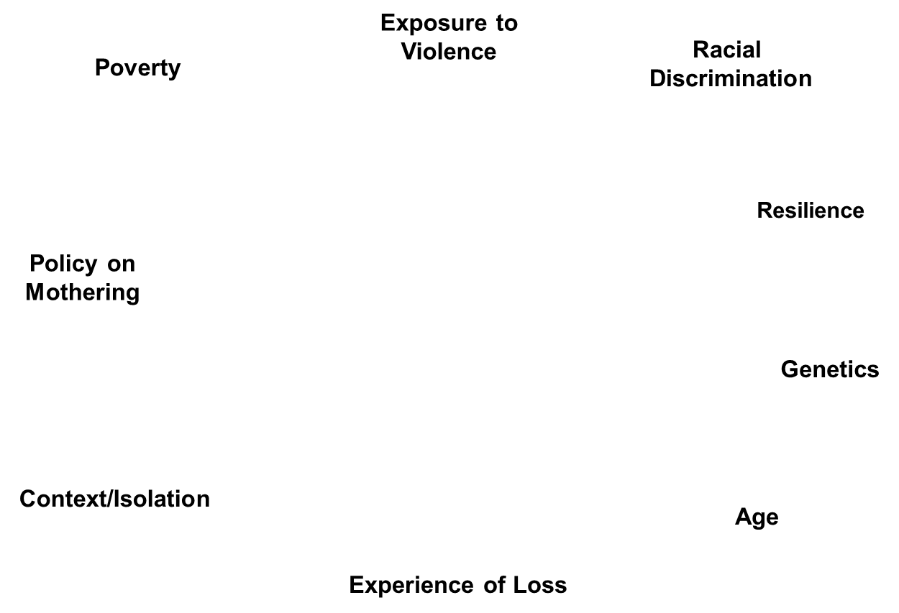
IT’S NOT ONLY ABOUT THE ALCOHOL
Mother’s nutrition
Mother’s use of other drugs
Mother’s Alcohol Use
Mother’s access to prenatal care
Mother’s overall health
Mother’s stress level

Slide 22
HOW TO PREVENT FASD?
1. Build public awareness and health promotion.
2. Discuss alcohol use and related risks with all women of childbearing years and their support networks.
3. Provide specialized, holistic support of pregnant women with alcohol and other health/social problems.
4. Support new mothers to maintain/initiate changes to support the development of their children.

Slide 23
NOW WHAT? WHAT CAN I DO?
GREAT QUESTION!!
What can you do?
Prevention efforts must move the focus from a woman’s alcohol use to understanding the related health and social problems that contribute to FASD.

Slide 24
HOW CAN WE MAKE A DIFFERENCE?
Promote FASD learning in your community
Advocate for planned pregnancies and healthy lifestyle choices
Keep learning about the complexities of FASD and how it affects people
Help when and how you can
Remember: FASD affects us ALL!

Slide 25
TURNING TO ONE ANOTHER
Turning to One Another: Simple Conversations to Restore Hope to the Future, 2002
        Margaret Wheatley

Slide 26
QUESTIONS?
Please feel free to tell other people, programs, agencies about the Prevention Conversation and have them call me if they want to schedule a presentation! I can present to almost anyone!

Slide 27
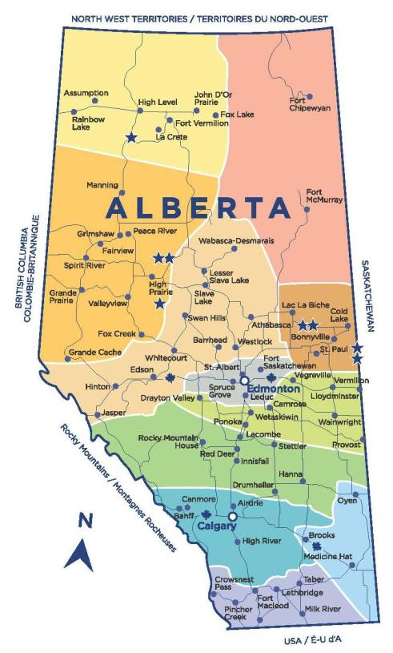
ALBERTA FASD SERVICE NETWORKS
Visit
fasd.alberta.ca
to link to the
FASD Service Network
in your area.

